Slide 1
BAMRR MRI Safety Week 2024
What happened- the incident
What is a significant adverse event
How to share learning
What happened afterwards
Recommendations and follow up
What is next in ‘incident reporting’ world

Slide 2
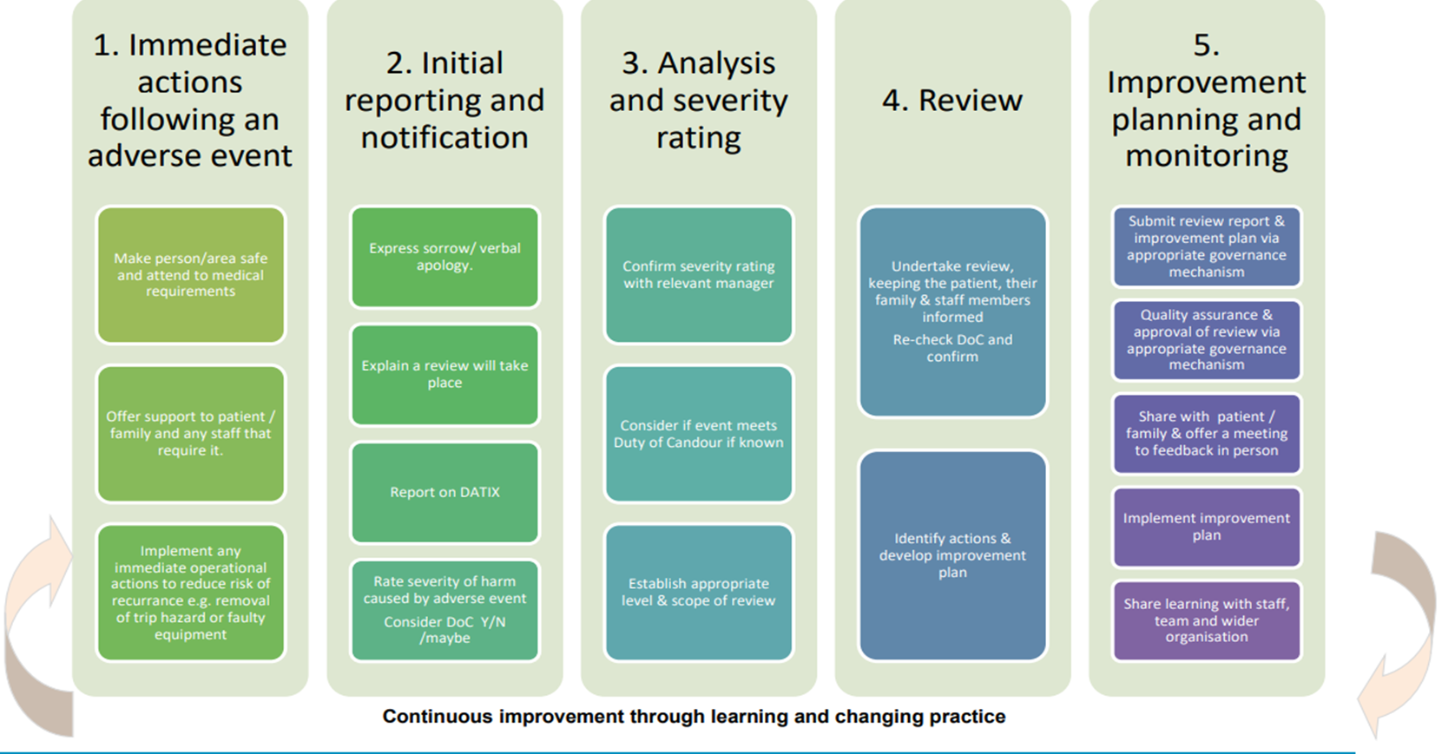
BAMRR MRI Safety Week 2024
Flowchart of actions to be taken to effectively manage adverse events
https://policyonline.nhslothian.scot/wpcontent/uploads/2023/03/Adverse%20Event%20Management%20Procedure.pdf

Slide 3
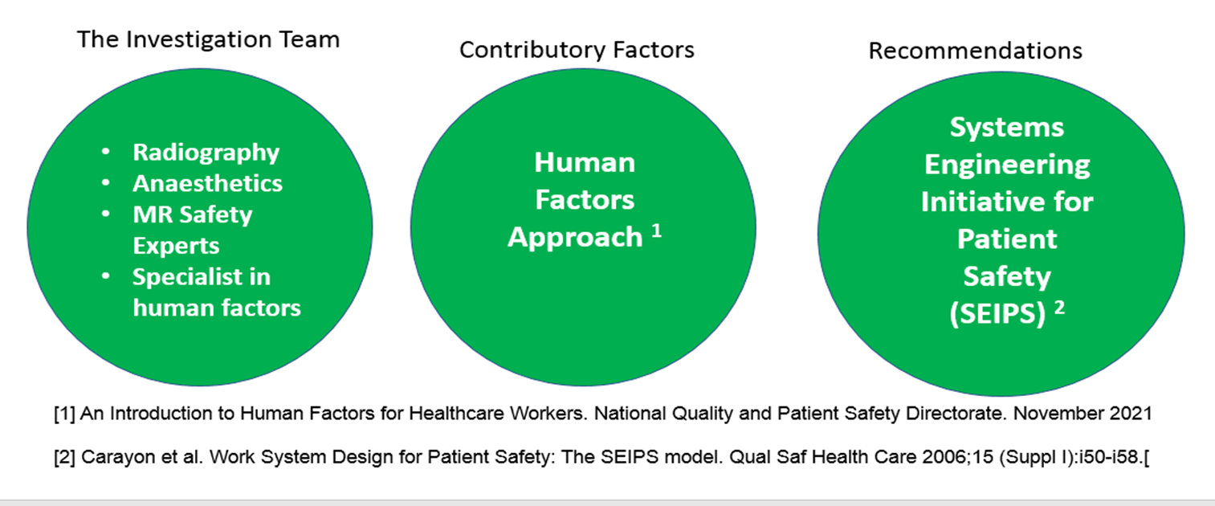
BAMRR MRI Safety Week 2024
An investigation was undertaken using a multi-disciplinary team and contributory factors were identified using a human factors approach.
Recommendations were made using a ‘Systems Engineering Initiative for Patient Safety’.
Slide courtesy of
Dr Gillian MacNaught
Lead MRI Physicist
Royal Infirmary Edinburgh

Slide 4
BAMRR MRI Safety Week 2024
The investigation focussed on the following factors, which will be discussed in turn:
1.
Task
&
Technology
2.
Patient
7. Institutional
Context
3.
Staff
6.
Organisation
& Management
5. Work Environment
4.
Team
Slide courtesy of
Dr Gillian MacNaught
Lead MRI Physicist
Royal Infirmary Edinburgh

Slide 5
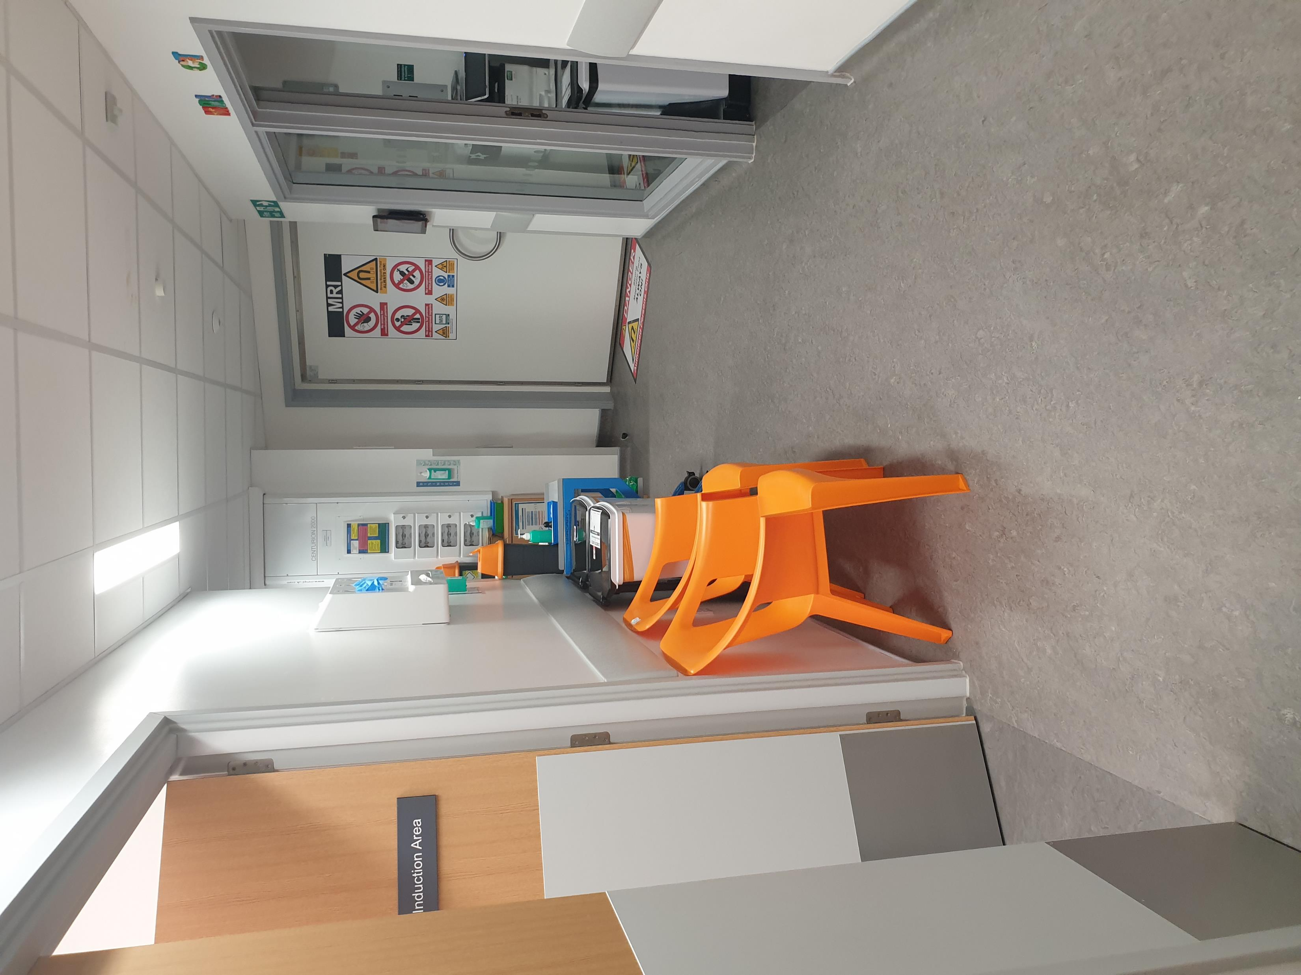
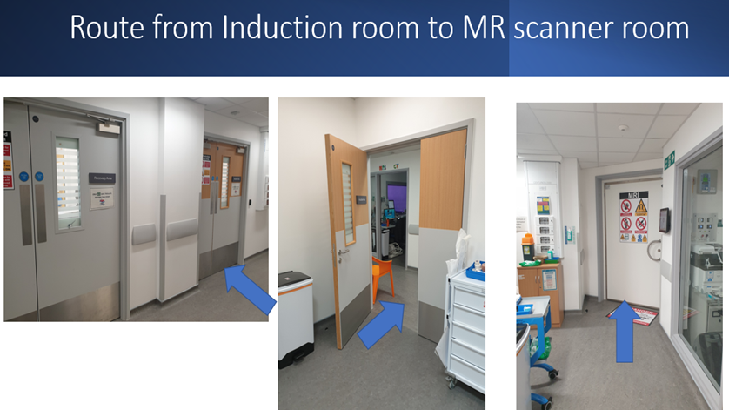
BAMRR MRI Safety Week 2024
Departmental Layout:
View of MR CAA
from main entrance
The MR CAA is delineated by the orange lines.
Changing
room
Changing
room
Trolley bay
CT Scanner Room
Slide courtesy of
Dr Gillian MacNaught
Lead MRI Physicist
Royal Infirmary
Edinburgh
Induction Room
Recovery Room
Control Room
wc
wc
Adjacent to DCN
MR CAA
3T Scanner Room
Unfortunately, there are multiple access points to the MR CAA The main entrance is through this door but there are additional access points via the induction room, recovery room and through CT scanner room
- - - - -
Equipment Rooms

Slide 6
BAMRR MRI Safety Week 2024
Finding:
Process Failings
1.
Task
&
Technology
1
Trolley bay
2
Induction Room
3
Recovery Room
Control Room
5
4
3T Scanner Room
Slide courtesy of
Dr Gillian MacNaught
Lead MRI Physicist
Royal Infirmary
Edinburgh

Slide 7
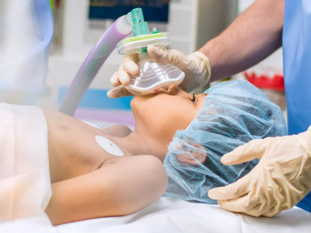
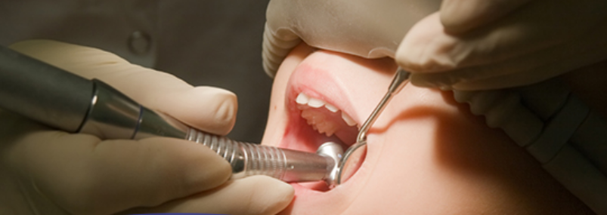
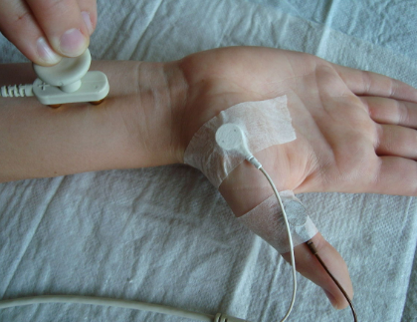
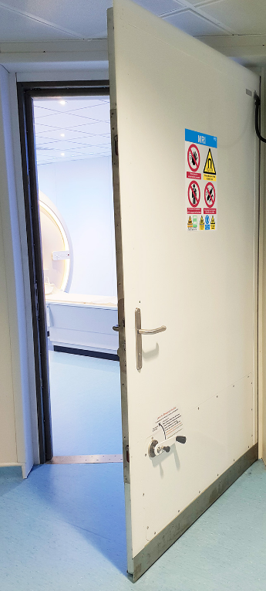
BAMRR MRI Safety Week 2024
Finding:
Reduced Focus on MRI
2.
Patient
3T MRI
Slide courtesy of
Dr Gillian MacNaught
Lead MRI Physicist
Royal Infirmary
Edinburgh

Slide 8
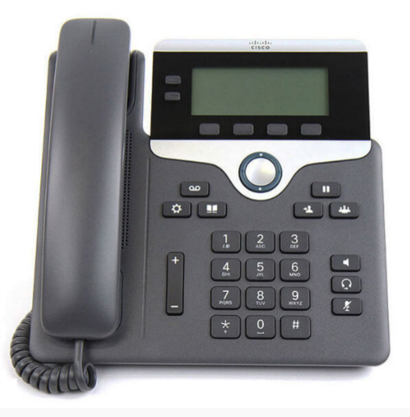
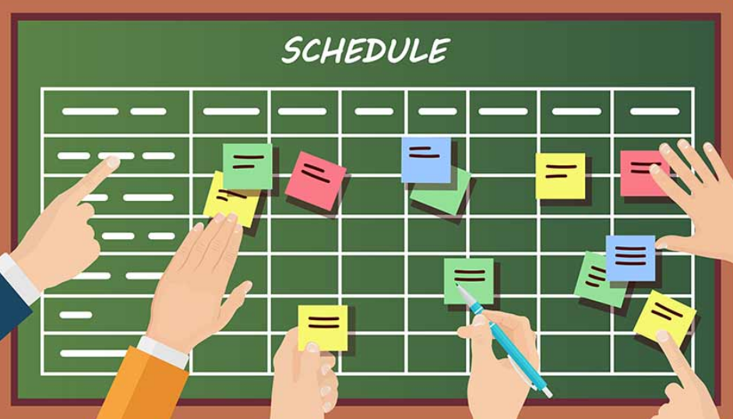
BAMRR MRI Safety Week 2024
Finding:
Distractions to the Main Task
Anaesthetic Consultant
- Induction room
3.
Staff
Radiographers – control room
3T MRI
Slide courtesy of
Dr Gillian MacNaught
Lead MRI Physicist
Royal Infirmary
Edinburgh

Slide 9

BAMRR MRI Safety Week 2024
Finding:
Lack of Clarity in Roles and Responsibilities
4.
Team
MR Radiographers
Radiology Department Assistant
Anaesthetists
Operating Department Practitioner
Slide courtesy of
Dr Gillian MacNaught
Lead MRI Physicist
Royal Infirmary
Edinburgh

Slide 10

BAMRR MRI Safety Week 2024
Finding:
Multiple staff groups waiting in MR CAA
5. Work Environment
CT
Induction Room
Recovery Room
Control Room
3T MRI
Slide courtesy of
Dr Gillian MacNaught
Lead MRI Physicist
Royal Infirmary
Edinburgh

Slide 11

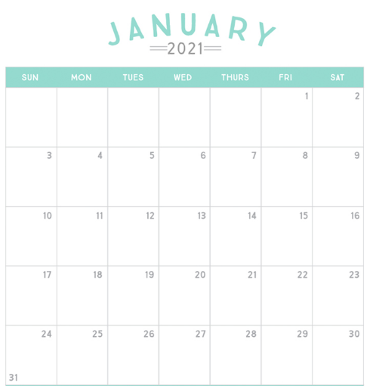
BAMRR MRI Safety Week 2024
Finding:
No written SOP’s and Training records not up to date
Standard Operating Procedure
6.
Organisation
& Management
MR Safety training update due!
Slide courtesy of
Dr Gillian MacNaught
Lead MRI Physicist
Royal Infirmary
Edinburgh

Slide 12
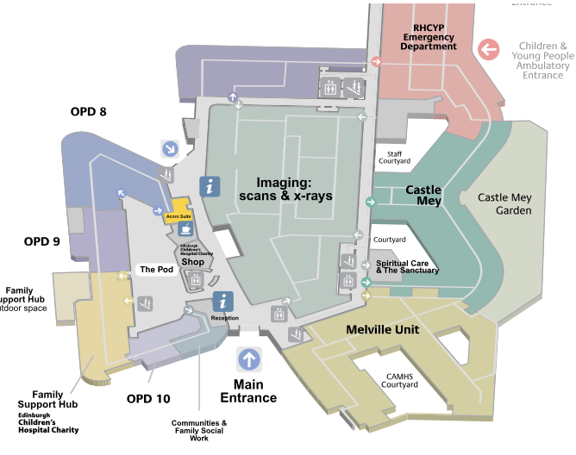
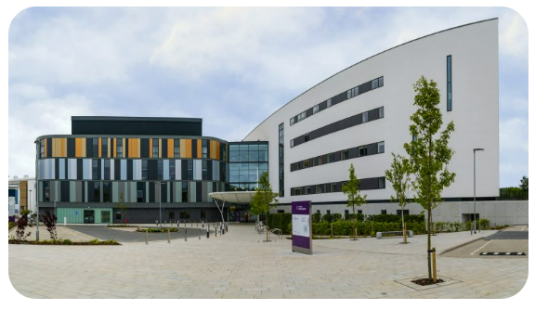
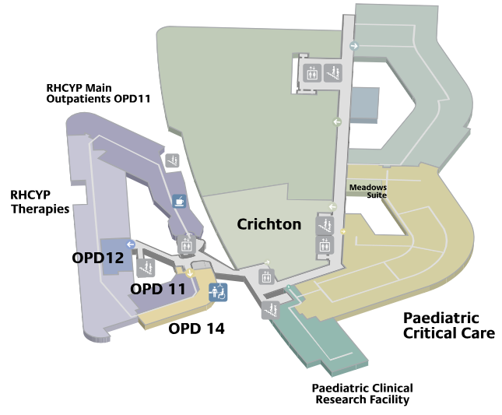
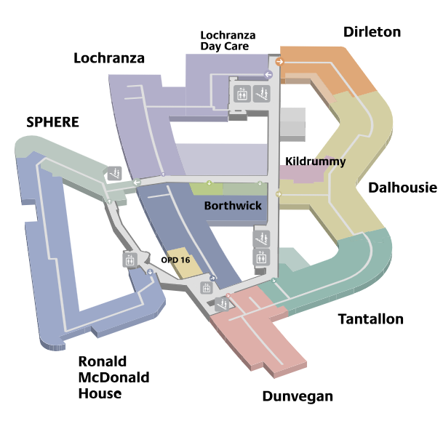
BAMRR MRI Safety Week 2024
Finding:
Royal Hospital for Children and Young People
had recently moved to a new building
7. Institutional
Context
Slide courtesy of
Dr Gillian MacNaught
Lead MRI Physicist
Royal Infirmary
Edinburgh

Slide 13
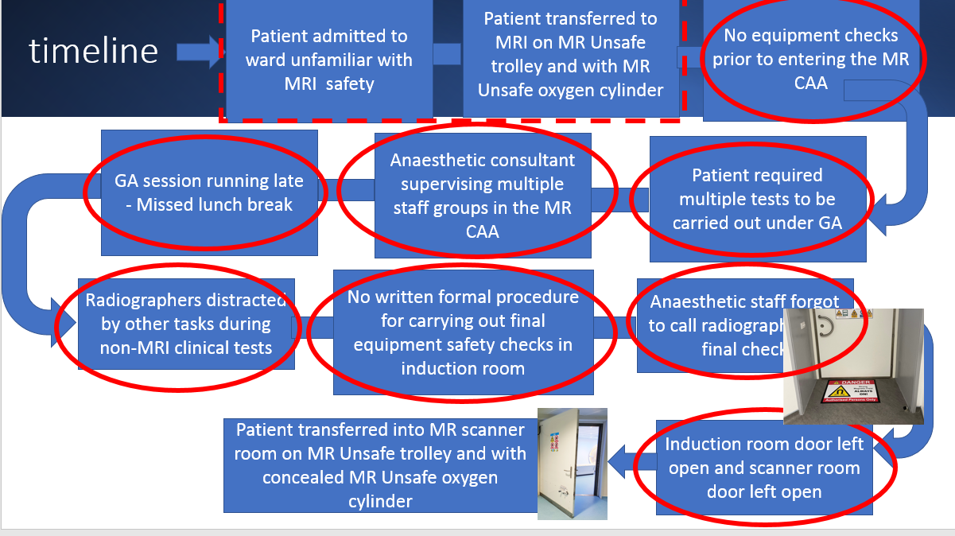
BAMRR MRI Safety Week 2024
Putting all these investigation findings into a timeline for the incident, this shows the series of events that led up to the critical moment, resembling the well known ‘Swiss cheese’ model of incidents when all the gaps or holes align…
Slide courtesy of
Dr Gillian MacNaught
Lead MRI Physicist
Royal Infirmary
Edinburgh

Slide 14
BAMRR MRI Safety Week 2024
BAMRR are also pleased to direct you to what BIR and ISMRT and SCoR have produced for MR Safety Week
https://bir.org.uk/get-involved/special-interest-groups/bir-magnetic-resonance.aspx
https://www.ismrm.org/mr-safety-links/mr-safety-week-2024/#:~:text=These%20virtual%20meetings%20are%20free,%E2%84%A2%20and%20Category%20A%20Credit.
https://www.sor.org/
Materials from MR Safety Week from previous years are available on the BAMRR website https://www.bamrr.org/safety/

