Slide 1
BAMRR MRI Safety Week 2024
What happened- the incident
What is a significant adverse event
How to share learning
What happened afterwards
Recommendations and follow up
What is next in ‘incident reporting’ world

Slide 2

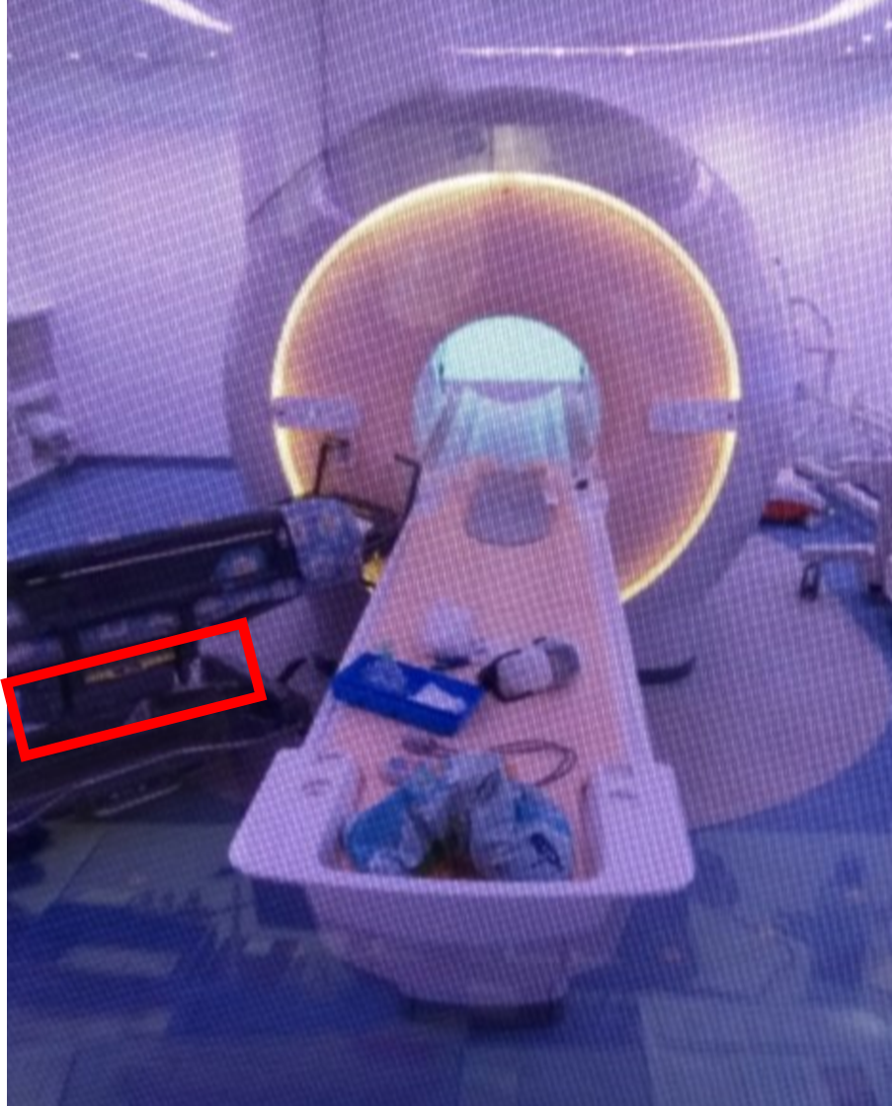
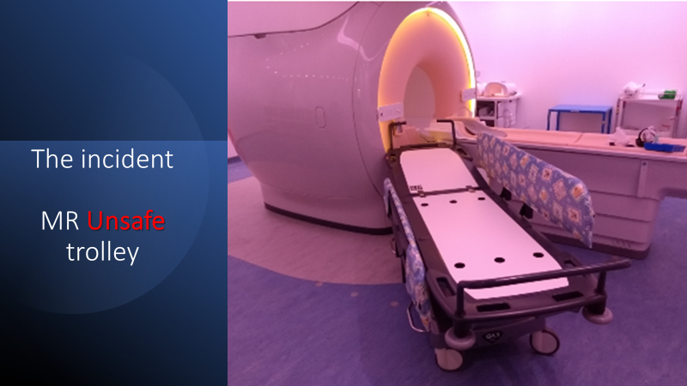
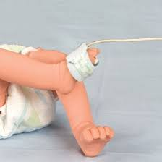
BAMRR MRI Safety Week 2024
3 Incidents :
MRI UNSAFE Trolley, MRI UNSAFE Oxygen Cylinder and MRI UNSAFE Pulse Oximeter
Actual Image from site shared with permission
Actual Image from site shared with permission
Representative image for example only

Slide 3
BAMRR MRI Safety Week 2024
What happened- the incident:
During a GA session in May 2021, a patient was accidently taken into the MR Environment on an MR UNSAFE trolley, which had an MR UNSAFE oxygen cylinder strapped underneath the trolley and the patient had an MR UNSAFE pulse oximeter on their finger. The trolley was pulled rapidly towards the magnet. Luckily the patient was unharmed and the anaesthetist only suffered a minor injury to their finger.
The oxygen cylinder was removed by an MRSE colleague and the scanner was ramped down by the vendor so the trolley could be removed.
The scanner was ramped back up and had only minor cosmetic damage.
As it could have resulted in significant injury or fatality, the incident was recorded as a SIGNIFICANT ADVERSE EVENT (SAE) and an extensive investigation followed.

Slide 4
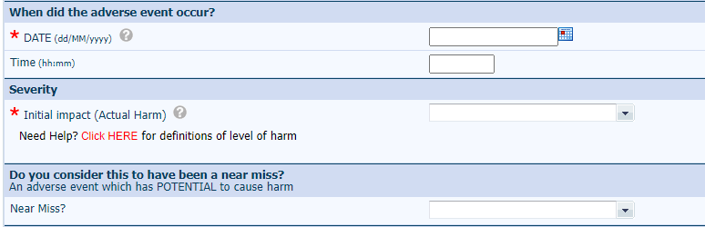


BAMRR MRI Safety Week 2024
A Significant Adverse Event (SAE) is defined as “an extraordinary event that could have, or did, have serious consequences, including immediate or delayed emotional reactions, physical or psychological harm for patients, public, staff or organisation”.
https://policyonline.nhslothian.scot/wpcontent/uploads/2023/03/Adverse%20Event%20Management%20Procedure.pdf
The incident was reported via:
Datix
IRIC (For NHS Scotland)
MHRA
RIDDOR
Other incident reporting systems are available – Are you familiar with yours ?

Slide 5
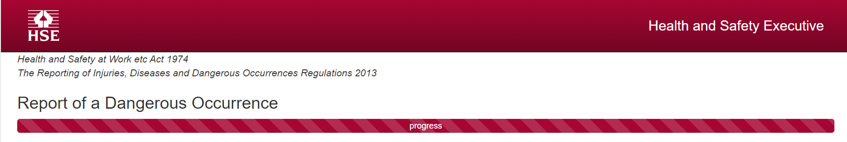
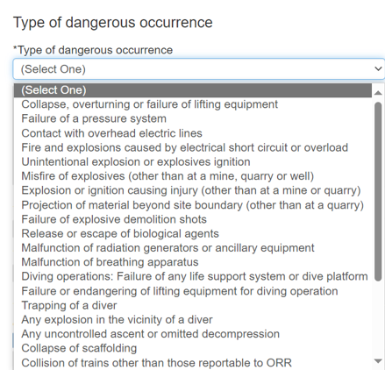
BAMRR MRI Safety Week 2024
RIDDOR (Reporting of Incidents, Diseases and Dangerous Occurrences Regulations) is the law that requires employers, and other people in charge
of work premises, to report and keep records of:
work-related accidents which cause deaths
work-related accidents which cause certain serious injuries
diagnosed cases of certain industrial diseases
incidents with the potential to cause harm
There are 27 reportable Dangerous occurrences under RIDDOR, but none were relevant to MRI and this incident.

Slide 6
BAMRR MRI Safety Week 2024
‘Shared learning’ can be used to inform staff of the details of an incident and the outcome of the investigation, including the key lessons learned and any actions to be taken following an adverse event.
It facilitates information to be shared with the team, with the intent for staff to learn from the incident and prevent future loss or damage.
This process helps to raise awareness, build and improve the safety culture.
The need to learn from events is critical to ongoing improvements in quality and safety.
The table overleaf provides an example of a shared learning template.

Slide 7
BAMRR MRI Safety Week 2024
What happened? | Describe the causes: | Corrective and Preventative Actions: | What was learnt? | Equity | What are the recommended actions for improvement?
Provide a brief description of the event, giving a summary of the circumstances surrounding the incident that resulted in the injury or safety event, what activities or operations were being performed and any known contributing factors to the incident. | Summarise the immediate and root causes of the incident. The immediate causes: substandard acts or conditions that led directly to the incident, e.g., a trolley was swapped over, personal protective equipment was misused, there was stress or fatigue, or poor concentration. The root causes: what the investigation identifies as the initial events or failings that led to all the other causes or failings. Had this initial event or failing been controlled, the incident would have been prevented. | Describe briefly any immediate or planned corrective actions, controls or countermeasures that will be implemented. Explain the steps that were taken to resolve the impact of the incident and the action required to prevent it from happening again. These measures will be connected to the identified causes of the incident. | Describe what learning opportunities arose during the process that are relevant to other providers and what current processes work well. | Describe any equity issues highlighted during the review process and what solutions were suggested. | Describe the system level actions for improvement being implemented in your organisation to address the learning.

Slide 8
BAMRR MRI Safety Week 2024
BAMRR are also pleased to direct you to what BIR and ISMRT and SCoR have produced for MR Safety Week
https://bir.org.uk/get-involved/special-interest-groups/bir-magnetic-resonance.aspx
https://www.ismrm.org/mr-safety-links/mr-safety-week-2024/#:~:text=These%20virtual%20meetings%20are%20free,%E2%84%A2%20and%20Category%20A%20Credit.
https://www.sor.org/
Materials from MR Safety Week from previous years are available on the BAMRR website https://www.bamrr.org/safety/

