Slide 1
BAMRR MRI Safety Week 2024
What is MRI Safety Week?
This week includes the anniversary of the tragic accident that resulted in the death of six-year-old Michael Colombini from a projectile incident (oxygen cylinder) during an MRI scan in America… July 27th, 2001.
https://abcnews.go.com/US/story?id=92745&page=1
To commemorate this, BAMRR will be producing safety and educational materials and collaborating with the British Institute of Radiology (BIR), International Society for MR Radiographers & Technologists (ISMRT) and the Society and College of Radiographers (SCoR) in sharing links.
What is BAMRR focusing on for MR Safety Week 2024?
This year for MRI Safety Week, we would like to focus on ‘Shared Learning from Incidents’.
Each day, BAMRR will discuss components of an incident- check our website daily
BAMRR would like to thank Dr Gillian MacNaught, Lead MRI Physicist, NHS Lothian, for her images and sharing the MRI team’s experience and full permission has been granted for use.

Slide 2

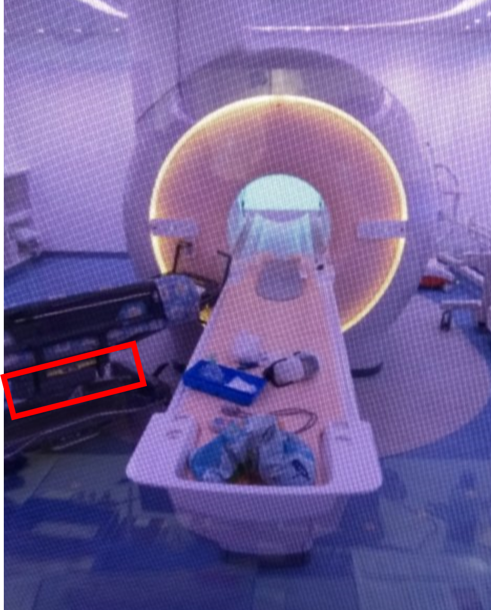
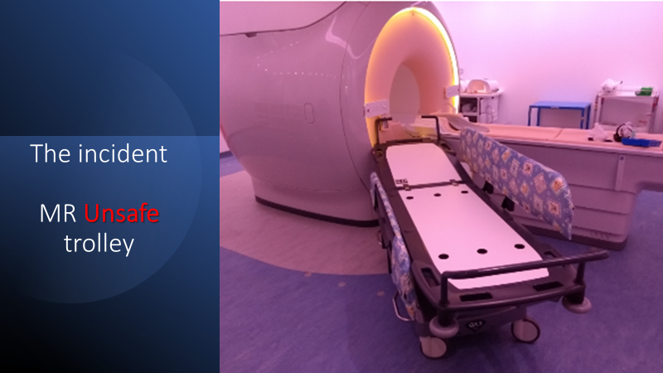
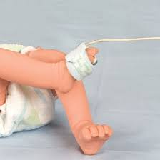
BAMRR MRI Safety Week 2024
3 Incidents :
MRI UNSAFE Trolley, MRI UNSAFE Oxygen Cylinder and MRI UNSAFE Pulse Oximeter
Actual Image from site shared with permission
Actual Image from site shared with permission
Representative image for example only

Slide 3
BAMRR MRI Safety Week 2024
Over the next few days, we will discuss:
What happened- the incident
What is a significant adverse event
How to share learning
What happened afterwards
Recommendations and follow up
What is next in ‘incident reporting’ world
BAMRR are also pleased to direct you to what BIR and ISMRT and SCoR have produced for MR Safety Week
https://bir.org.uk/get-involved/special-interest-groups/bir-magnetic-resonance.aspx
https://www.ismrm.org/mr-safety-links/mr-safety-week-2024/#:~:text=These%20virtual%20meetings%20are%20free,%E2%84%A2%20and%20Category%20A%20Credit.
https://www.sor.org/
Materials from MR Safety Week from previous years are available on the BAMRR website https://www.bamrr.org/safety/

