Slide 1
BAMRR MRI Safety Week 2024
What happened- the incident
What is a significant adverse event
How to share learning
What happened afterwards
Recommendations and follow up
What is next in ‘incident reporting’ world

Slide 2
BAMRR MRI Safety Week 2024
There is a new national incident learning system
in clinical imaging, MRI and nuclear medicine.
Please find more information on the
following website
https://www.gov.uk/government/publications/national-coding-taxonomy-for-incident-learning-in-clinical-imaging-mri-and-nuclear-medicine

Slide 3

BAMRR MRI Safety Week 2024
Finally BAMRR hopes you have found the information about the relationship between a significant adverse event and shared learning useful and BAMRR would like to thank Dr Gillian MacNaught once again for her images and permission to share this incident.
Please check out our website for membership options, our upcoming courses and our annual conference.
Hope to see you at one of our events soon
BAMRR ☺
https://ergonomics.org.uk/resource/learning-from-adverse-events.html

Slide 4
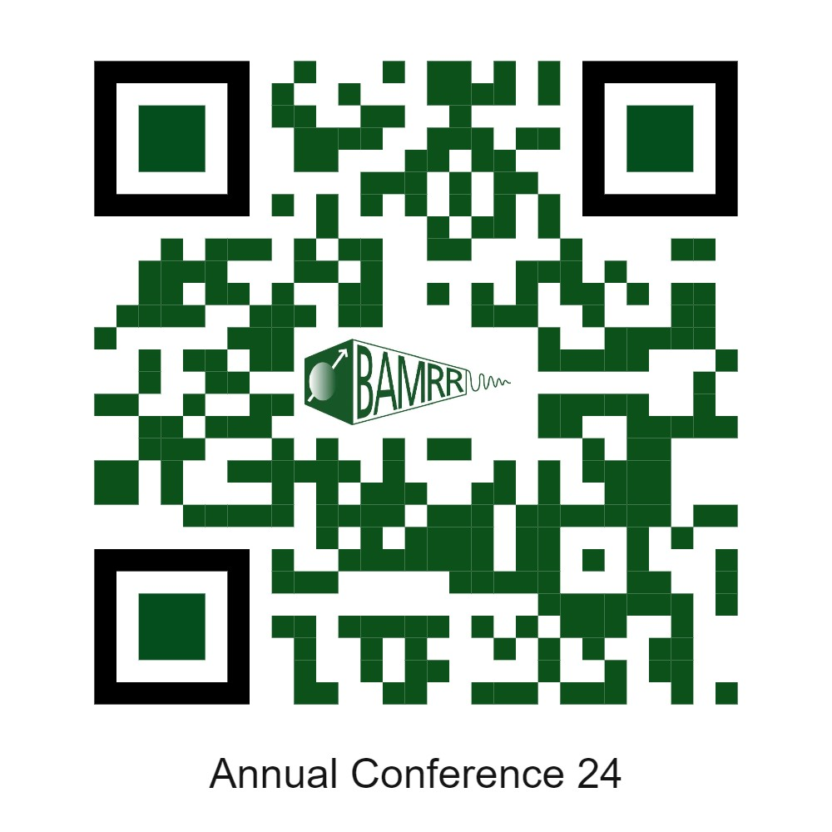
BAMRR MRI Safety Week 2024
BAMRR are also pleased to direct you to what BIR and ISMRT and SCoR have produced for MR Safety Week
https://bir.org.uk/get-involved/special-interest-groups/bir-magnetic-resonance.aspx
https://www.ismrm.org/mr-safety-links/mr-safety-week-2024/#:~:text=These%20virtual%20meetings%20are%20free,%E2%84%A2%20and%20Category%20A%20Credit.
https://www.sor.org/
Materials from MR Safety Week from previous years are available on the BAMRR website https://www.bamrr.org/safety/
The BAMRR 2024 Annual Conference includes more MRI safety.
Click below or Scan the QR code for more details:
BAMRR 2024 Annual Conference - Details and Registration

