Slide 1
BAMRR MRI Safety Week 2024
What happened- the incident
What is a significant adverse event
How to share learning
What happened afterwards
Recommendations and follow up
What is next in ‘incident reporting’ world

Slide 2
BAMRR MRI Safety Week 2024
Principles for incorporating human factors into learning investigations
Avoid searching for blame
Adopt a systemic approach
Recognise the potential for difference between the way work is imagingined & the way work is done
Accept a broad range of types and standards of evidence
Seek oportunities for learning beyond actual loss events
Identify & understand both situational & contextual factors
Accept that learning means changing
Understand learning will only last if change is embedded in a culture of learning & continous improvement
Do not confuse recommendations with solutions
Designed by author (RW)
https://ergonomics.org.uk/resource/learning-from-adverse-events.html

Slide 3
BAMRR MRI Safety Week 2024
Recommendations and
Actions
Slide courtesy of
Dr Gillian MacNaught
Lead MRI Physicist
Royal Infirmary Edinburgh

Slide 4
BAMRR MRI Safety Week 2024
The report highlighted the incident was more complex than first thought, as there were so many contributing factors.
Immediate changes in practice included:
SOP for GA procedure, with recorded ‘Pause and Check’ with an MR Authorised Person (supervisor)
SOP for equipment checking prior to entering the MR CAA
Training around the level of authorisation of staff, roles and responsibilities, including appointing a “Lead Authorised Person (Supervisor) for each scanner for the day, for all sessions, not just GA’s
Tightening up on physical safety (Shut scanner room door and adding floor stickers and a physical plastic chain across the scanner room door)
  Ensure MRI scan takes priority in MR GA session
  Moving the location of MR GA list to Intraoperative MR suite
  Anaesthesia WHO Checklist modified with final pause and check procedure
Slide courtesy of
Dr Gillian MacNaught
Lead MRI Physicist
Royal Infirmary Edinburgh

Slide 5
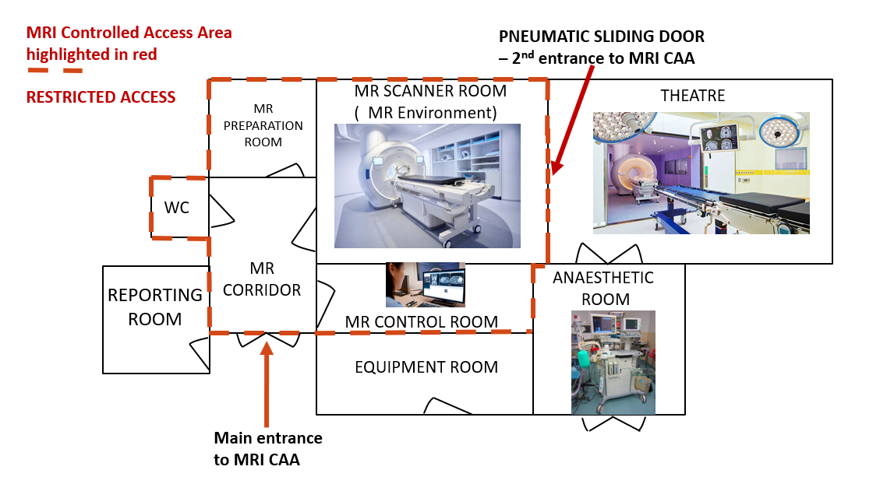
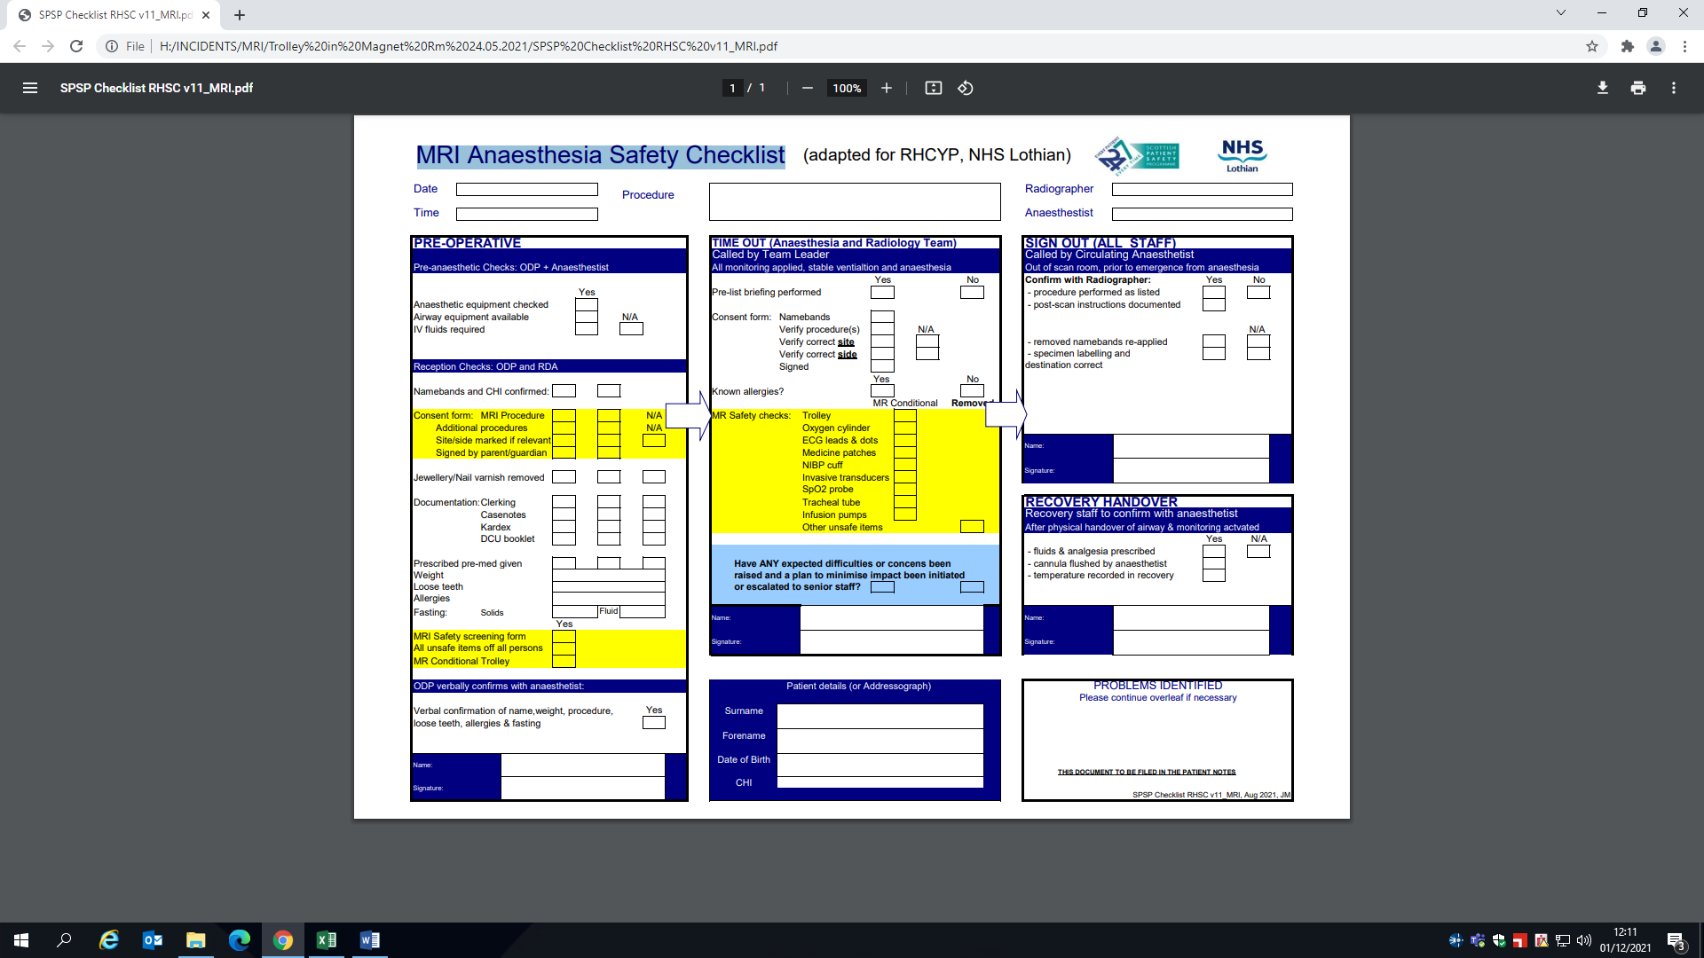
BAMRR MRI Safety Week 2024
Immediate Changes:
Slide courtesy of
Dr Gillian MacNaught
Lead MRI Physicist
Royal Infirmary Edinburgh

Slide 6
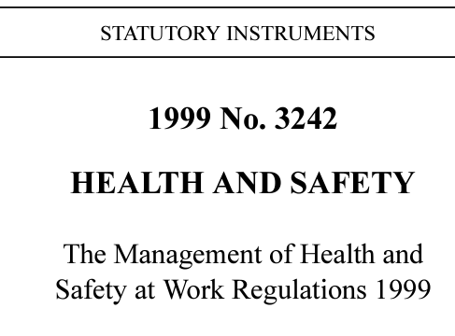

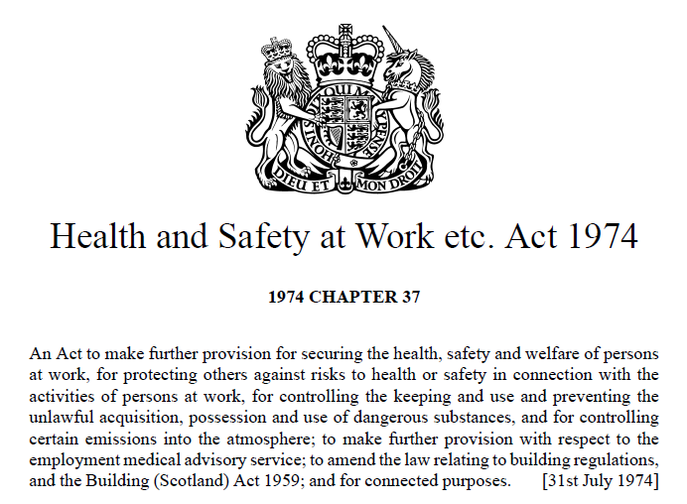

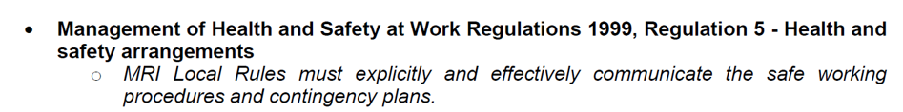
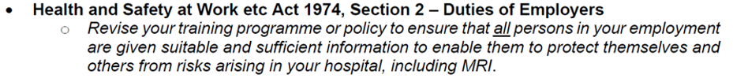
BAMRR MRI Safety Week 2024
A ‘Notice of Contravention’ explains how Health and Safety Legislation has been broken and the time limit given to provide evidence to the HSE that this breach has been adequately addressed.
“It is understood that after the trolley had been attracted to the scanner and become stuck, the patient was removed safely, but that the oxygen cylinder remained in the room. The cylinder was then removed by one of your employees, without safety arrangements in place.”
“I understand that whilst all employees who work within your MRI controlled area receive MRI safety training, other employees are not given any information or instructions regarding the risks associated with MRI scanners.
Those employees who currently do not receive any MRI safety training, instruction or information include ward staff and porters.”
Slide courtesy of
Dr Gillian MacNaught
Lead MRI Physicist
Royal Infirmary Edinburgh

Slide 7
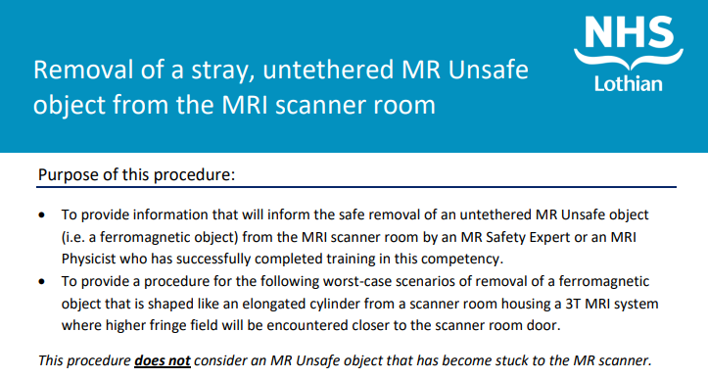
BAMRR MRI Safety Week 2024
Local Rules updated to communicate the safe working procedures and contingency plans
Slide courtesy of
Dr Gillian MacNaught
Lead MRI Physicist
Royal Infirmary Edinburgh

Slide 8
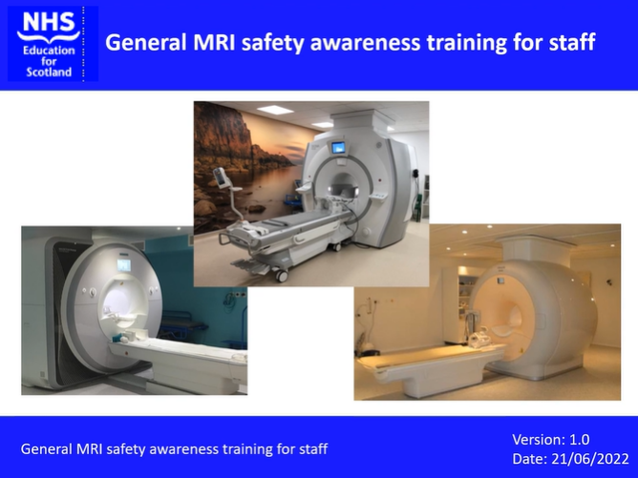
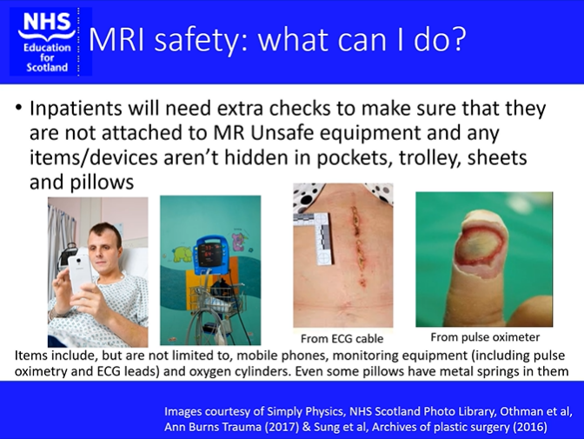
BAMRR MRI Safety Week 2024
Our response – training video for all staff groups
Slide courtesy of
Dr Gillian MacNaught
Lead MRI Physicist
Royal Infirmary Edinburgh

Slide 9
BAMRR MRI Safety Week 2024
In Conclusion:
Health and Safety legislation
MHRA
MRI Safety
Guidelines
Slide courtesy of
Dr Gillian MacNaught
Lead MRI Physicist
Royal Infirmary Edinburgh

Slide 10
BAMRR MRI Safety Week 2024
BAMRR are also pleased to direct you to what BIR and ISMRT and SCoR have produced for MR Safety Week
https://bir.org.uk/get-involved/special-interest-groups/bir-magnetic-resonance.aspx
https://www.ismrm.org/mr-safety-links/mr-safety-week-2024/#:~:text=These%20virtual%20meetings%20are%20free,%E2%84%A2%20and%20Category%20A%20Credit.
https://www.sor.org/
Materials from MR Safety Week from previous years are available on the BAMRR website https://www.bamrr.org/safety/

